Slide 1
Functional Approach to write code
By Mykhailo Torskyi

Slide 2
What is the advantage of functional programming?
Functional programming ensures simpler flow control in our code and avoids any surprises in the form of variable and state changes. All this helps us avoid bugs and understand our code easily.

Slide 3
What functional programming isn't
Loops
while
do...while
for
for...of
for...in
Variable declarations with var or let
Void functions
Object mutation (for example: o.x = 5;)

Slide 4
Array mutator methods
copyWithin
fill
Pop
Push
Reverse
shift
Sort
Splice
Unshift
Map mutator methods
clear
delete
set
Set mutator methods
add

Slide 5
Functional Programming in JavaScript
JavaScript already has some functions that enable functional programming. Example:
String.prototype.slice
Array.protoype.filter
Array.prototype.join
Const variables

Slide 6
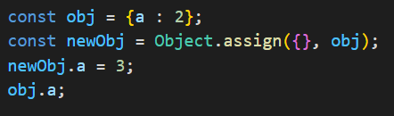
Object.assign
Object.assign copies values from the provided object to a new object. Since functional programming is predicated on immutable data, we use it to make new objects based on existing objects

Slide 7
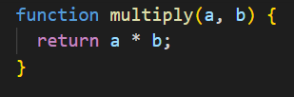
Pure function
Referential transparency: The function always gives the same return value for the same arguments. This means that the function cannot depend on any mutable state.
Side-effect free: The function cannot cause any side effects. Side effects may include I/O, modifying a mutable object, reassigning a variable, etc.

Slide 8
Currying
Informally, currying is the process of taking a function that accepts n arguments and turning it into n functions that each accepts a single argument. The arity of a function is the number of arguments that it accepts. A function that accepts a single argument is unary, two arguments binary, three arguments ternary, and n arguments is n-ary.

Slide 9

Composition
Composition is defined as passing the output of one function into input of another so as to create a combined output

Slide 10
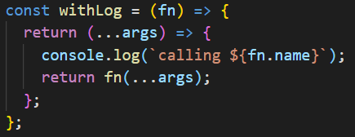
Higher-order Functions
Higher-order functions are functions that accept a function as an argument and return a function. Often, they are used to add to the functionality of a function

Slide 11


